Slide 1
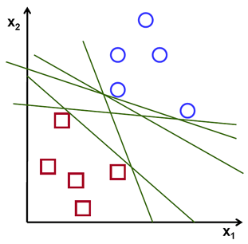
Support vector machines
A Support Vector Machine (SVM) is a discriminative classifier formally defined by a separating hyperplane.
Given labeled training data (supervised learning), the algorithm outputs an optimal hyperplane which categorizes new examples.
Consider the following simple problem: For a linearly separable set of 2D-points which belong to one of two classes, find a separating straight line.

Slide 2
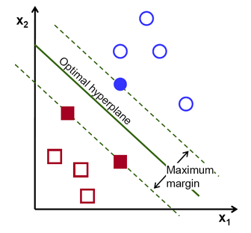
SVM
There exists multiple lines that offer a solution to the problem. Is any of them better than the others?
We can intuitively define a criterion to estimate the worth of the lines: A line is bad if it passes too close to the points because it will be noise sensitive and it will not generalize correctly.
Therefore, our goal should be to find the line passing as far as possible from all points.
The operation of the SVM algorithm is based on finding the hyperplane that gives the largest minimum distance to the training examples - margin.
The optimal separating hyperplane maximizes the margin of the training data.

Slide 3
SVM Parameters
svm = cv.ml.SVM_create()
svm.setType(cv.ml.SVM_C_SVC)
svm.setKernel(cv.ml.SVM_LINEAR)
svm.setTermCriteria((cv.TERM_CRITERIA_MAX_ITER, 100, 1e-6))
SVM Type: The type C_SVC that can be used for n-class classification (n ≥ 2). The important feature of this type is that it deals with imperfect separation of classes (i.e. when the training data is non-linearly separable).
SVM Kernel Type: It is a mapping done to the training data to improve its resemblance to a linearly separable set of data. This mapping consists of increasing the dimensionality of the data and is done efficiently using a kernel function. We choose here the type LINEAR which means that no mapping is done.

Slide 4
SVM PARAMETERS
Termination criteria of the algorithm. The SVM training procedure is implemented solving a constrained quadratic optimization problem in an iterative fashion.
Specify a maximum number of iterations and a tolerance error so we allow the algorithm to finish in less number of steps even if the optimal hyperplane has not been computed yet.
Train the SVM using the method svm.train to build the SVM model.
svm.train(trainingData, cv.ml.ROW_SAMPLE, labels)

Slide 5
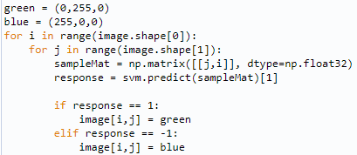

Sample Code
In the below code an image is traversed interpreting its pixels as points of the Cartesian plane.
Each of the points is colored depending on the class predicted by the SVM; in green if it is the class with label 1 and in blue if it is the class with label -1.
The method getSupportVectors obtain all of the support vectors.
Use this method to find the training examples that are support vectors.

Slide 6
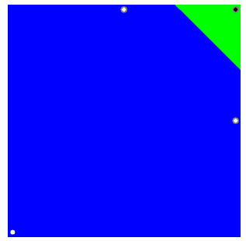
SAMPLE OUTPUT

Slide 7
SVM for Non-Linearly Separable Data
Most of the applications in which SVMs are used in computer vision require a more powerful tool than a simple linear classifier.
In these tasks the training data can be rarely separated using an hyperplane.
Consider the case of face detection.
The training data in this case is composed by a set of images that are faces and another set of images that are non-faces (every other thing in the world except from faces).
This training data is too complex so as to find a representation of each sample (feature vector) that could make the whole set of faces linearly separable from the whole set of non-faces.
Since the training data is now non-linearly separable, the hyperplane found will misclassify some of the samples.
This misclassification is a new variable in the optimization that must be taken into account.
The new model has to include both the requirement of finding the hyperplane that gives the biggest margin and the new one of generalizing the training data correctly by not allowing o many classification errors.

Slide 8
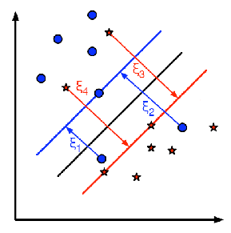
SVM for Non-Linearly Separable Data
There are multiple ways in which this model can be modified so it takes into account the misclassification errors.
A better solution will take into account the distance of the misclassified samples (C) to their correct decision regions.
For each sample of the training data a new parameter ξi is defined.
Each one of these parameters contains the distance from its corresponding training sample to their correct decision region.
The picture shows non-linearly separable training data from two classes, a separating hyperplane and the distances to their correct regions of the samples that are misclassified.
The red and blue lines that appear on the picture are the margins to each one of the decision regions.
Each of the ξi goes from a misclassified training sample to the margin of its appropriate region.

Slide 9
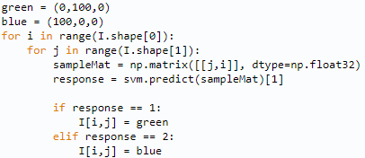
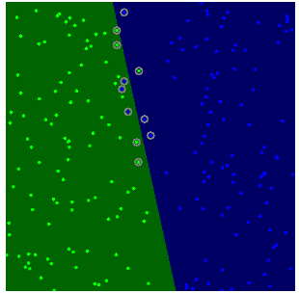
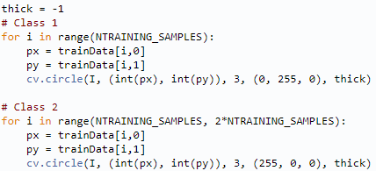
Sample Code & Output
Large values of C give solutions with less misclassification errors but a smaller margin.
Small values of C give solutions with bigger margin and more classification errors.

Slide 10
Binary and multiclass classification
Binary Classification:
In this type, the machine should classify an instance as only one of two classes; yes/no, 1/0, or true/false.
The classification question in this type is always in the form of yes/no. For example, does this image contain a tumor?
Multiclass Classification:
In this type, the machine should classify an instance as only one of three classes or more.
Eg: Facial Expression Recognition; Age Classification.

Slide 11
References
https://docs.opencv.org/4.x/d1/d73/tutorial_introduction_to_svm.html
https://docs.opencv.org/4.x/d0/dcc/tutorial_non_linear_svms.html

